Slide 2
We make IoT work
Mission Statement
As guardians of the connected world, we deliver best in class digital transformation, cyber security, and quality assurance solutions; enabling our clients to embrace and harness the power of the digital future.
Our Vision
To empower the connected world to be resilient, secure and seamlessly share data in order to enhance the end-user customer experience.

Slide 3
Our Solutions
Systems QA Tests for End-User & Business Solutions
Content Perfecting a Higher State of Media Content
Devices Test Solutions for your Digital Devices
Cyber Security Protecting your Most Valuable Business Assets

Slide 4
Our Offices
Global Coverage
Resillion is a world leader in providing end-to-end quality assurance, testing solutions and cyber security. With an ongoing investment into growing our products and services portfolio and increasing our geographical coverage, we are committed to ensuring the quality of the products and services delivered to our clients.

Slide 5
Test monitoring tool

Slide 6
Test monitoring tool
The goal
Analyzing tool for logs
Complex testlogs (=challenge)
Predict issues/problems
Extensive report (classification)
AI
Analyzing
Isolating
Providing context

Slide 7
Test monitoring tool
Value
A lot of manual intervention required
2-3 employees
Repetition

Slide 8
Test monitoring tool
Planning

Slide 9
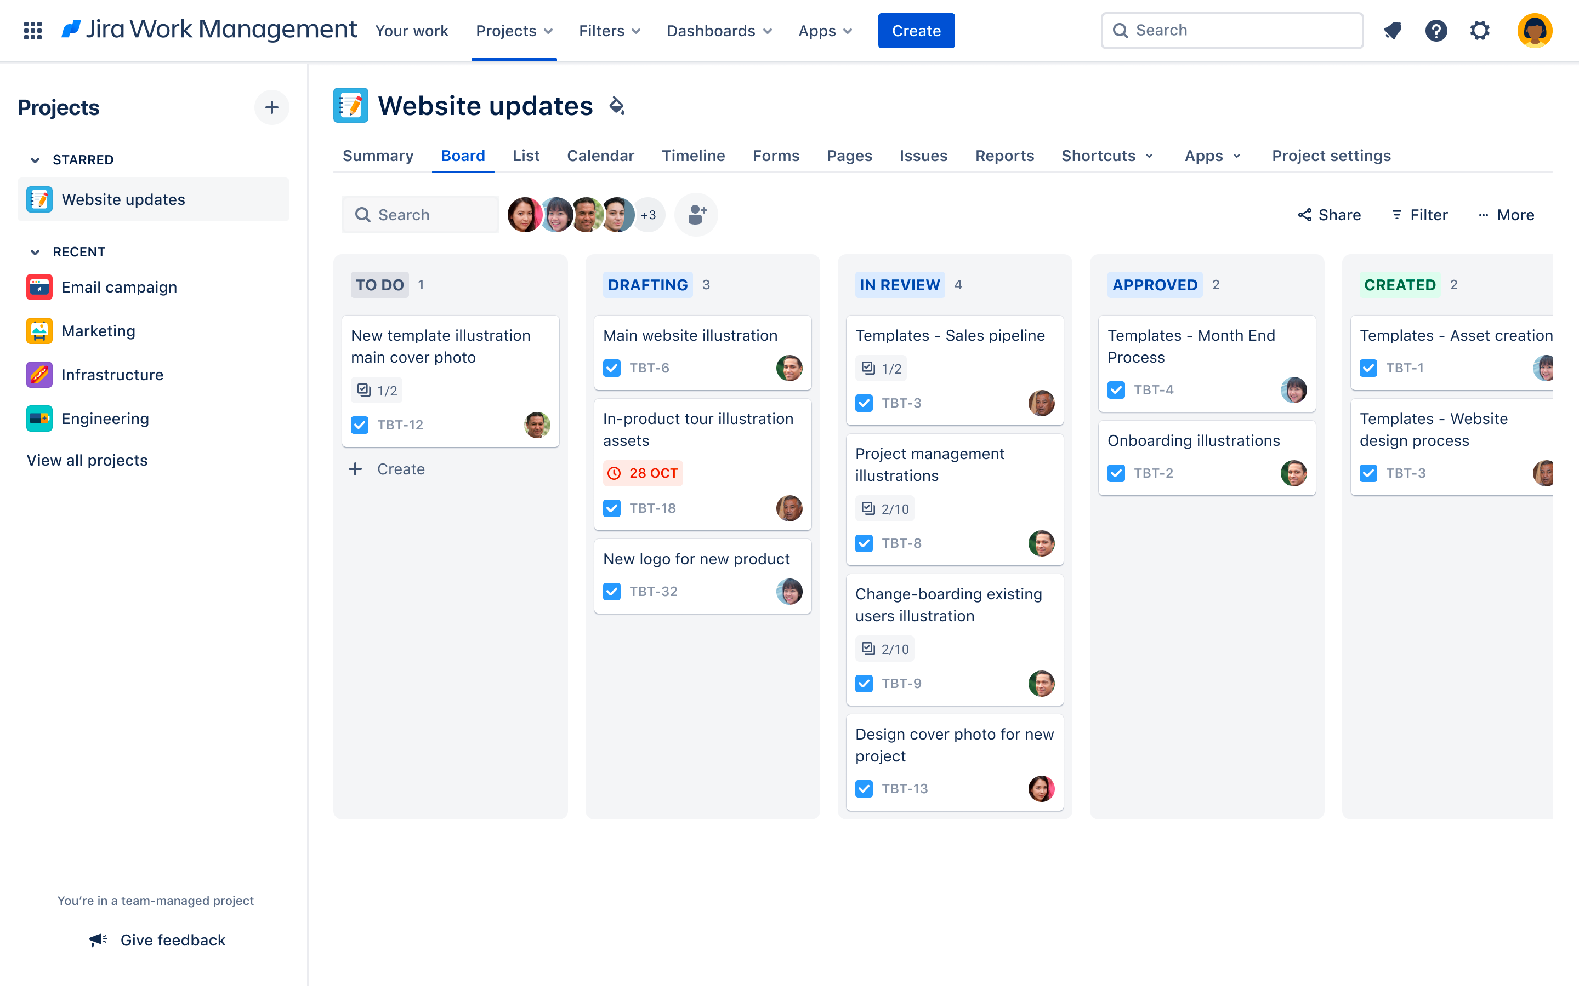
Communication
Daily stand-up
Weekly activity report
Bi-weekly demo
Weekly HR conversation
Jira - Kanban

